Slide 1
Integrating Episodic Future Thinking into Virtual Reality to Mitigate Substance Use Disorders: A Theoretical Framework
Presenter: Tianzi Wang
Co-authors: Alexandra M. Mellis, Nathan Lau, Warren Bickel
Notes:
Hello everyone, my name is Tianzi, I am a PhD student at VT and a member of VACSE supervised by Dr. Nathan Lau. Today I’m presenting our study about a theoretical approach of integrating the concept of episodic future thinking into immersive virtual reality to treat substance use disorders.

Slide 2
Motivation
Substance use disorders (SUDs) present major health risks and economic burdens.
In the US, 63,632 people were killed by drug overdoses in 2016, 66.4% of these involving opioids (National Institute on Drug Abuse, 2018).
The cost of alcohol use disorder is $249 billion annually in crime, health and lost productivity (Sacks et al, 2015).
However, current healthcare systems face insufficient resources and accessibility deficiencies that challenge long term treatment for chronic diseases.
Notes:
Tz: Substance use disorders present major health risks and economic burdens. Based on the statistic of national institute on drug abuse, 60 thousands of people were killed by drug overdoses in the U.S. 2016. The death rate of all kinds of substance use keep increasing since 1999 (Fig left). The cost of alcohol use disorder is $249 billion annually in crime, health and lost productivity.
While current healthcare systems face insufficient resources and accessibility deficiencies that challenge long term treatment for chronic diseases (Fig right).
Categories: Alcohol, Opiates, Cannabis, Psychostimulants, Amphetamine, Cocaine

Slide 3
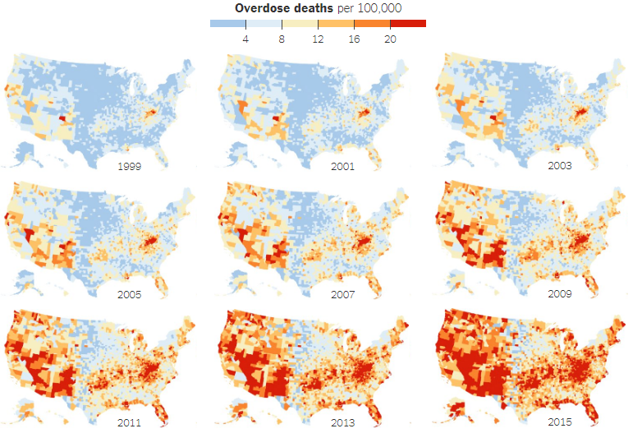
Overdose deaths per 100,000, United States
(H. Park and M. Bloch 2016)
Notes:
The overdose deaths spread widely and horribly around the United States from 1999 to 2015. Here is the epidemic trend.

Slide 4
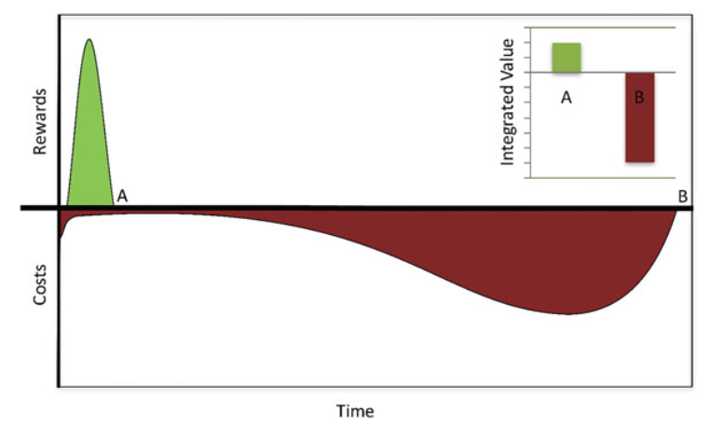
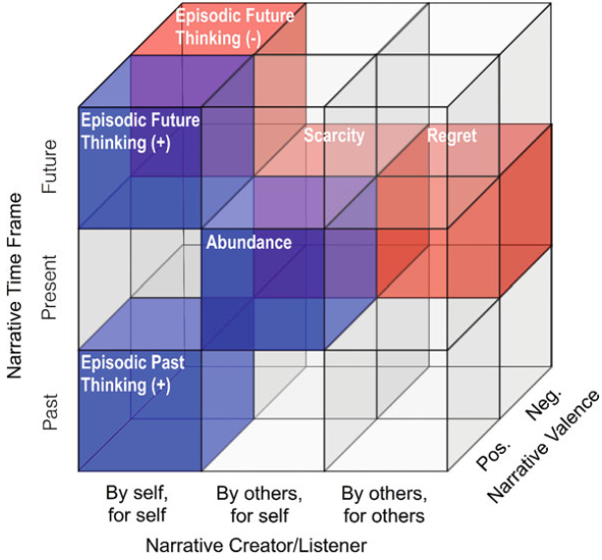

Narrative theory
HEALTHY LIFE
Executive
Impulsive
Decision system
Narrative theory (Bickel, 2017)
Notes:
One of the theories that can explain the addiction to the substance is the reinforcer pathology, where Narrative theory can intervene.
People valued more on immediate short term rewards than the same amount of long term rewards. This phenomenon is extremely obvious on people have substance abuse problems. Their window of the short term is narrower than general level. When this happens, there will be an imbalance of the impulsive and executive decisions. Then, people prefer the unhealthy life immediate happy to a long term healthy life style.
Narrative theory discussed the possibility of intervene the situation by adjusting the three dimensions on time, autobiographic, and positive/negative emotion of people’s thinking about an events. Episodic future thinking aims at prompting participants to deliberate on details of future, personal and positive events that expanding the temporal window. That people can rebalance the impulsive and executive decision systems and thereby reducing the valuation of substances of abuse.

Slide 5












Episodic future thinking
Episodic future thinking (EFT) refers to projecting oneself into the future and pre-experiencing an event (Atance & O’Neill, 2001).
Components:
Vivid details
Future oriented
For self
Positive
Birthday Party
Future episodes
Notes:
Episodic future thinking (EFT) refers to projecting oneself into the future and pre-experiencing an event.
It is commonly facilitated through the narrative interviews. Such as an interview about a birthday party:
“I will be attending a friend’s birthday party one month later in her house. There will be some music playing, balloons drifted around, snacks and beers. A birthday cake is placed in the middle of the table. We will be chatting and playing games, then singing the happy birthday song.”
For EFT to be effective, individuals must be able to concretely pre-experience the future events. It should be as vivid, personal, and positive. The benefits would partly depend on an individual’s cognitive ability or imagination.

Slide 6


Narrative theory, EFT and SUDs therapy
EFT can expand user’s temporal window of reinforcer valuation, reducing the desire for immediate gratification and thus substance valuation.
VR
Schema
SUD
Therapy
Narrative
Theory
EFT
Narrative Interview
Notes:
In summary, EFT can expand user’s temporal window of reinforcer valuation, reducing the desire for immediate gratification and thus substance valuation. Current practice to facilitate EFT is narrative interviews with cuing questions to promote autobiographic, vivid, positive and future oriented nature of thinking for reducing substance valuation.

Slide 7
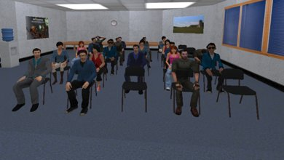
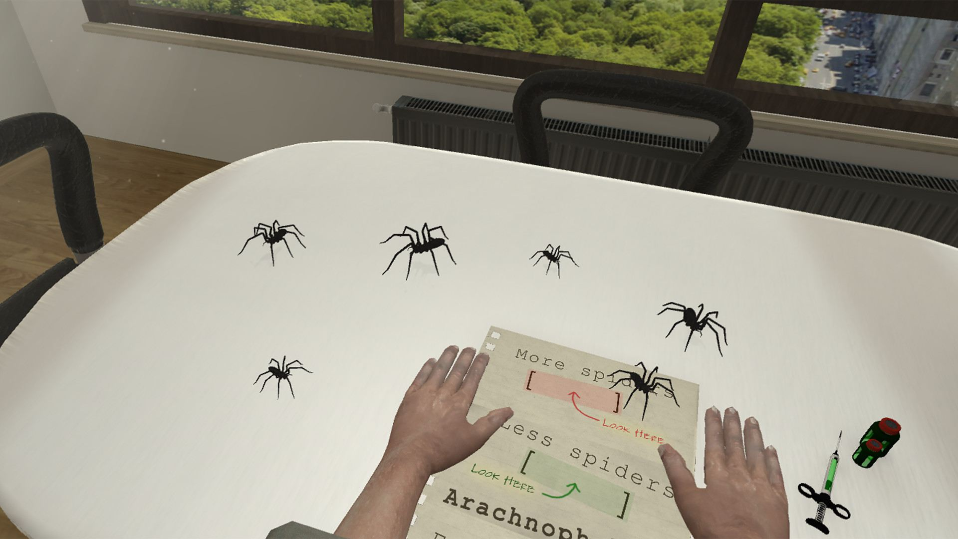
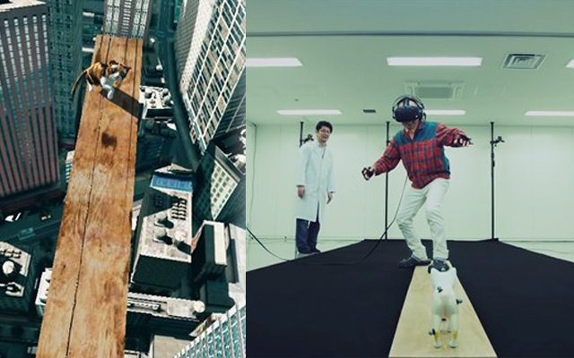
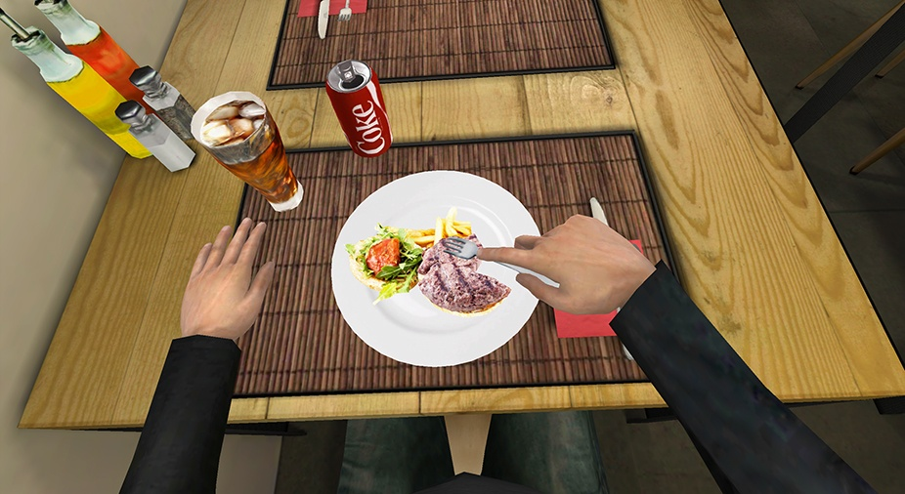
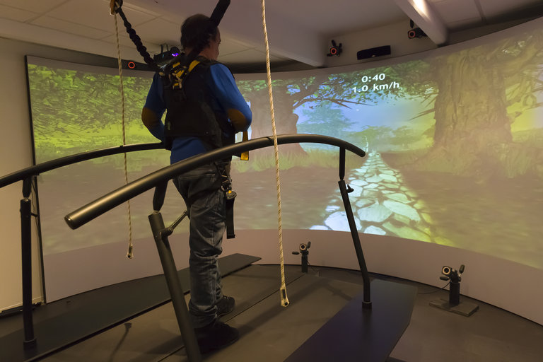
Teletherapy in virtual reality
VR can provide multi-sensorial perception and interaction experiences to enhance the properties of EFT. In particular, the virtual world can present the people, objects, setting, time, and activities of a future event (i.e., EFT cues).
Image ref 5,6,7,8,9
VR supports EFT to treat SUDs in following ways:
Facilitate mental time travel.
Have factors affecting presence effects the quality of episodic thought.
VR studies in medical domain.
Notes:
Virtual reality (VR) refers to a high-end user interface that involves real-time simulation and interaction through multiple human body sensorial channels such as vision, sound, touch. These multi-sensorial perception and interaction experiences can be designed to enhance the properties of EFT. In particular, the virtual world can present the people, objects, setting, time, and activities of a future event in a manner that makes the episode more positive, vivid, autobiographical, future-oriented, and memorable. In turn, the boundary of EFT, such as imagination and memory, should be alleviated through the realistic experience or “presence” in the virtual world.
VR has been studied in medical domain for exposure therapy for phobia of public speaking, spider, fear of height, or eating disorder, recovery for post stroke patient.
The literature provides preliminary evidence on how VR could support EFT to treat SUDs. First it facilitates mental time travel. Second, it has factors affecting presence such as visual realism, sound, haptics, virtual body representation, body engagement resemble those contributing to the quality of episodic thought, which is an integration of several basic human body systems.
VR is a novel technology, with an appropriate design, it can be employed to generate contexts and cues to promote EFT and potentiate its treatment effect in SUDs.

Slide 8

Schema theory
Schema theory can provide a strong basis to guide design of environment, activities, objects and social elements in VR.
Schema for VR design:
Prototype schemas:
realistic context
Object schemas:
objects
Scripts:
activities
time
events
Social schema:
people
What? (object)
Where? (context)
Who? (people)
How?
(activities)
When? (time)
Notes:
Schema theory can provide a strong basis to guide design of environment, activities, objects and social elements in VR. Schema theory postulates that human thinking and knowledge are organized into schema.
The literature presents different types of schemas, four of which are particularly relevant for designing virtual experiences to facilitate EFT.

Slide 9
Our framework
Applying schema theory to guide the design of
virtual reality (VR) for facilitating
episodic future thinking (EFT)
to conduct SUDs therapy.
VR
Schema
SUD
Therapy
Narrative
Theory
EFT
Narrative Interview
Notes:
We propose a theory-driven design framework of applying schema theory to guide design of VR for facilitating EFT to treat SUDs.
This framework employs existing EFT research to identify future events that substance users have shown to reduce substance valuation. Schema of those events is then applied to determine the contents of virtual world and experience in such events.

Slide 10
Schema-based VR for promoting EFT
Events are decomposed into five design dimensions (i.e., where, what, how, when, who) that individuals deliberate to strengthen their EFT.
Birthday Party | EFT | Schema theory | VR
Indoor, outdoor | Where | Environment prototype | Virtual scene
Balloons, wrapped presents, a birthday cake | What | Object | Virtual Object
Singing Happy Birthday song | How | Script | Interaction
In one month | When | Time | Storyline
Family, friends | Who | Role of people | Virtual Avatar
Schema-based VR for promoting EFT: An example of birthday party.
Notes:
Schema theory postulates that human thinking and knowledge are organized into schema

Slide 11



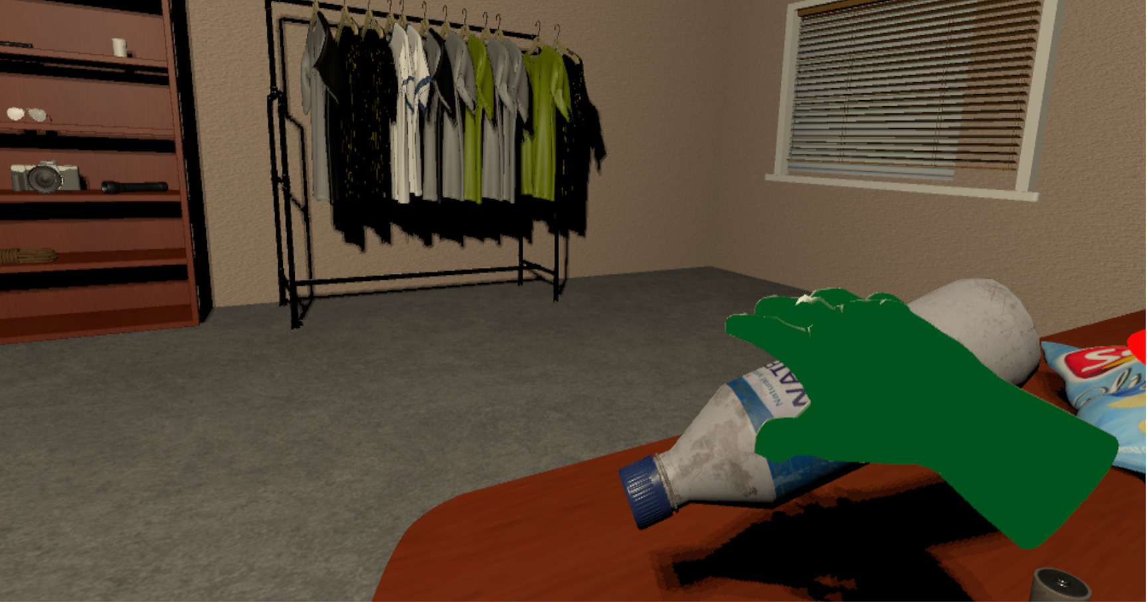










VR EFT therapy
a.
Components
Where: VR scenes of different events.
Object: reasonable, high fidelity
Story line: target, rewards, free roaming
Social: avatars, photos
Time: dates, calendar, seasons of the scene
Interactive objects
Personalization
Options
Interactions
b.
c.
d.
Figures. a) beach, b) camping, c) park, d) interaction e) time forward
e.
Notes:
Here are some examples that we did as different scenarios with different locations, different time period, interactions that people can make their own choice during the therapy. Such as camping next week in a park, or taking a vacation at beach in 2 month. Although, the VR design would also need customizable features that personalized expectation of a sofa could be various a lot.

Slide 12
Summary and conclusion
In this paper, we proposed a theory-driven design framework of applying schema theory to guide design of VR for facilitating EFT to treat SUDs.
Episodic future thinking can be applied to extend the temporal window in which an individual integrates the value of rewards.
VR can facilitate EFT by providing realistic contexts, cues and activities to represent future experiences.
Schema theory is applied to determine the patterns of thoughts and behaviors relevant for envisioning future events for designing VR experience to facilitate EFT.
VR
Schema
Narrative
Theory
EFT
SUD
Therapy
Narrative Interview
Notes:
We propose a theory-driven design framework of applying schema theory to guide design of VR for facilitating EFT to treat SUD.
This framework employs existing EFT research to identify future events that substance users have shown to reduce substance valuation. Using VR to facilitate EFT by providing realistic contexts, cues and activities to represent future experiences.
Schema of those events is then applied to determine the contents of virtual world and experience in such events.

Slide 13
Reference
1. National Institute on Drug Abuse. (2018, July 2). Commonly Abused Drugs Charts.
2. Sacks, J. J., Gonzales, K. R., Bouchery, E. E., Tomedi, L. E., & Brewer, R. D. (2015). 2010 national and state costs of excessive alcohol consumption. American Journal of Preventive Medicine, 49(5), e73–e79.
3. H. Park and M. Bloch, “How the Epidemic of Drug Overdose Deaths Rippled Across America,” The New York Times, 19-Jan-2016.
4. Bickel, W. K., Stein, J. S., Moody, L. N., Snider, S. E., Mellis, A. M., & Quisenberry, A. J. (2017). Toward narrative theory: Interventions for reinforcer pathology in health behavior. In Impulsivity (pp. 227-267). Springer, Cham.
5. “Public Speaking Simulator - WEARVR.” [Online]. Available: https://www.wearvr.com/apps/public-speaking-simulator. [Accessed: 20-Jan-2019].
6. “Virtual Reality Arachnophobia Therapy Is A Definite Nope | Kotaku Australia.” [Online]. Available: https://www.kotaku.com.au/2016/06/virtual-reality-arachnophobia-therapy-is-a-definite-nope/. [Accessed: 20-Jan-2019].
7. K. A. Hirchak and S. M. Murphy, “Assessing differences in the availability of opioid addiction therapy options: Rural versus urban and American Indian reservation versus nonreservation,” The Journal of Rural Health, vol. 33, no. 1, pp. 102–109, 2017.
8. “How Virtual Reality Is Being Used to Treat Eating Disorders - WSJ.” [Online]. Available: https://www.wsj.com/articles/virtual-reality-is-being-used-to-treat-eating-disorders-1532537334. [Accessed: 20-Jan-2019].
9. “Virtual Reality Training Can Aid in Stroke Recovery - Seeker.” [Online]. Available: https://www.seeker.com/tech/virtual-reality-training-can-help-people-recover-from-strokes. [Accessed: 20-Jan-2019].
Notes:
Here are the reference I used in the slides

Slide 14
THANK YOU
Tianzi Wang, Virginia Tech
Email: tianzi@vt.edu
Notes:
Thank you everyone!

